Slide 1











Report Date: 2025-10-29
Cost Optimization Best Practices in AWS
Maximize ROI while maintaining cloud agility and scalability
AWS
$avings
Optimize
Strategic approaches to reduce costs
enhance operational efficiency
© 2025 Cloud Cost Management
Cost Optimization Series

Slide 2













Introduction
Why Cost Optimization Matters
Maximizes return on investment (ROI) in AWS
Maximize ROI
Maintains agility and scalability in cloud computing
Get the most value from your cloud investment
Ensures sustainable cloud growth
Helps manage expenditure effectively
Cloud Agility
Maintain flexibility while reducing costs
Our Approach
Sustainable Growth
This presentation covers the essential best practices across key pillars:
Ensure long-term cloud viability
Visibility & Monitoring
Compute Optimization
Storage Optimization
Modernization & Governance
2/13

Slide 3
















Visibility and Monitoring
The cornerstone of effective AWS cost optimization lies in thorough understanding and continuous tracking of your cloud spending.
AWS Cost Explorer
AWS Budgets
Visualize, understand, and manage AWS costs and usage over time. Analyze spending patterns, identify trends, and forecast future costs.
Set custom budgets that alert you when costs or usage exceed (or are forecasted to exceed) budgeted amounts. Prevent unexpected overspending.
AWS Cost and Usage Reports (CUR)
AWS Cost Anomaly Detection
Automatically identifies unusual spending patterns using machine learning and alerts you to potential cost anomalies for quick resolution.
Provides comprehensive AWS cost and usage data. Delivers highly granular details about usage and associated costs for in-depth analysis.
Key Point: Without clear visibility into where and how costs are incurred, it's impossible to implement targeted optimization strategies.
3/13

Slide 4






















Tagging and Allocation
Cost Allocation Tags
Benefits of Tagging
Labels applied to AWS resources to organize them by categories for cost attribution.
Accurate Cost Allocation
Attribute costs to specific business units
Common Tag Categories
Project
Department
Environment
Chargeback & Showback
Implement models for cost recovery
Owner
Accountability
Implementation Tips
Foster cost-conscious behavior
Apply tags consistently across resources
Use automated tagging where possible
Tagging Impact
Tags → Organization → Insights
4/13

Slide 5

















Optimizing Compute Costs: Pricing Models
AWS offers various pricing models to help optimize compute costs based on your workload characteristics and commitment level.
On-Demand
Reserved Instances
Savings Plans
Spot Instances
Unpredictable workloads
Flexible instance usage
Fault-tolerant workloads
Steady-state workloads
No commitment
1-3 years
No commitment
1-3 years
Savings Potential
None
Savings Potential
Up to 72%
Savings Potential
Up to 90%
Savings Potential
Up to 72%
Key Considerations
Select based on workload predictability
Consider interruption tolerance
5/13

Slide 6























Rightsizing Resources
Tools for Rightsizing
What is Rightsizing?
Provisioning compute resources to precisely match actual workload needs, avoiding the common pitfall of over-provisioning.
AWS Compute Optimizer
Analyzes configuration and utilization metrics to recommend optimal instance sizes
Eliminates waste from idle capacity
Cost Explorer
Reduces unnecessary expenses
Identifies underutilized EC2 instances through resource optimization reports
Rightsizing Benefits
AWS Trusted Advisor
Before Rightsizing
After Rightsizing
Provides recommendations for optimizing various AWS resources, including EC2 instances
Over-provisioned
Optimized
6/13

Slide 7












Automating Elasticity
Leveraging AWS Elasticity
EC2 Auto Scaling Groups
Mixed Instance Types
Automating elasticity allows you to dynamically scale compute capacity to align with real-time demand, ensuring optimal performance while minimizing costs.
Configure ASGs with fine-tuned scaling policies
Balance On-Demand instances for critical workloads
Automatically add or remove instances based on demand
Use Spot Instances for fault-tolerant tasks
Schedule Workloads
Managed Services Auto-Scaling
Key Benefits
Pay only for resources actually used
Use AWS Instance Scheduler to shut down non-production resources
Apply auto-scaling to DynamoDB, ECS, RDS
Prevent over-provisioning during low demand
Schedule resources to run only during business hours
Extend to serverless architectures (Lambda concurrency)
Ensure sufficient capacity during peak times
7/13

Slide 8























Storage and Data Optimization: Smart Tiering
S3 Intelligent-Tiering
How Smart Tiering Works
Automatically moves objects between two access tiers based on changing access patterns
S3 Intelligent-Tiering
Automatic tiering based on access patterns
Seamless transition between frequent and infrequent access without performance impact
Frequent Access Tier
Infrequent Access Tier
Can automatically move rarely accessed data to archive access tiers
High IOPS, low latency
Lower cost, higher retrieval latency
Archive Tier
S3 Lifecycle Policies
Lowest cost, highest retrieval latency
Define rules to automatically transition objects to different storage classes
S3 Lifecycle Policies
Automate storage class transitions
Configure automatic expiration of objects after a specified period
Ensure data is stored in the most cost-effective tier throughout its lifecycle
Standard
Standard-IA
Glacier
Pro Tip: Combine Intelligent-Tiering with Lifecycle Policies for optimal cost savings
8/13

Slide 9




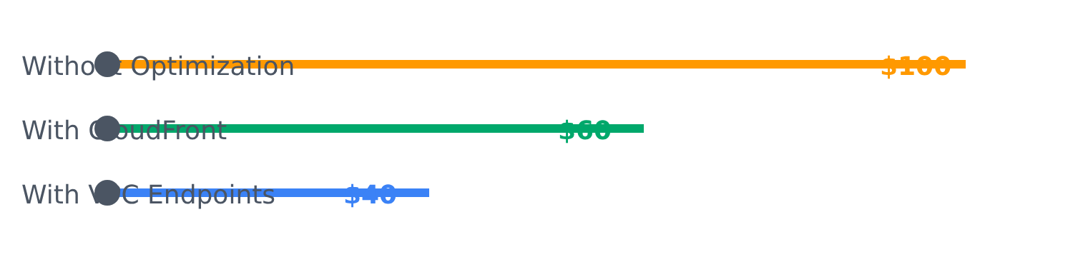












Reducing Data Transfer Fees
Data transfer costs, especially for egress to the internet or between regions, can accumulate rapidly. Strategic approaches can significantly mitigate these expenses.
Amazon CloudFront (CDN)
Caches content at edge locations globally, reducing the amount of data transferred directly from origin servers.
Improves content delivery speed
Data Transfer Cost Comparison
VPC Endpoints
Allows traffic to remain within the AWS network, bypassing the internet gateway and NAT Gateway.
Eliminates data transfer charges
Reduced Costs
Improved Performance
Lower data transfer fees
Faster content delivery
Optimize Data Paths
Enhanced Security
Optimized Architecture
Monitor data flow patterns and redesign application architectures to minimize cross-region and public internet egress traffic.
Limited exposure to internet
Better resource placement
Consolidate workloads within regions
9/13

Slide 10





















Cleanup Unused Resources
Why It Matters
Unattached EBS Volumes
Old Snapshots
EBS snapshots and RDS snapshots can accumulate over time, especially if retention policies are not strictly enforced.
Orphaned or unattached resources continue to incur costs without providing any value.
Block storage volumes that are no longer connected to an EC2 instance continue to incur charges.
Regular identification and deletion of these resources are essential for cost savings.
Regularly review and delete unused volumes
Implement snapshot lifecycle management
Idle Elastic IPs
Unused Load Balancers
Potential Impact
Elastic IP addresses that are not associated with a running EC2 instance or network interface incur a small hourly charge.
Application Load Balancers (ALBs) and Network Load Balancers (NLBs) that are no longer routing traffic should be removed.
Eliminates unnecessary charges
Improves resource management
Enhances account security
Release unused Elastic IPs
Clean up idle load balancers
Regular cleanup should be part of your cost optimization strategy
10/13

Slide 11

















Leveraging Managed Services
Adopting managed services reduces operational overhead and leads to substantial cost savings through pay-per-use pricing models.
Serverless Architectures
Container Services
Managed Databases
Pay-per-use: only pay for compute time consumed
Run containers without provisioning servers
Reduces database administration costs
Eliminates costs for idle servers
Reduces administrative overhead
Handles patching, backups, and maintenance
Highly cost-effective for event-driven workloads
More cost-efficient than managing EC2 instances
Pay-per-use pricing model
Example: AWS Lambda
Example: AWS Fargate
Example: Amazon Aurora
Key Benefit: Managed services eliminate costs associated with idle compute and infrastructure maintenance.
11/13

Slide 12

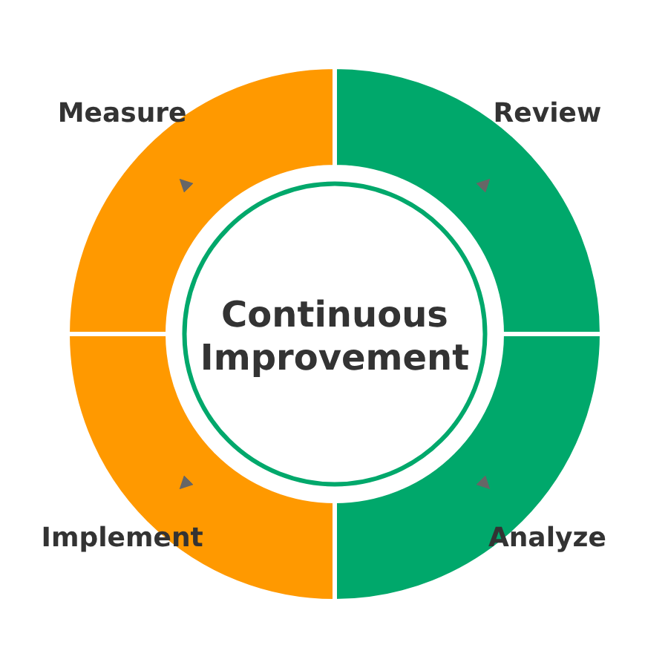









Continuous Improvement
Cost optimization is an ongoing process
Regular Reviews
Review Trusted Advisor and Cost Optimization Hub
Newer Instance Generations
Migrate to AWS Graviton-based instances
Automate Lifecycle Policies
Implement automated storage and backup policies
Cultural Approach
Integrate cost optimization into development
Use AI-driven optimization tools
Cost Optimization Best Practices
12/13

Slide 13



















Key Takeaways
Visibility & Monitoring
Rightsizing & Optimization
Use AWS Cost Explorer, Budgets, and CUR. Implement robust tagging for cost allocation.
Match resources to workload needs. Use AWS Compute Optimizer and Trusted Advisor.
Pricing Models
Automation & Elasticity
Maximize ROI
Select On-Demand, RIs, Savings Plans, or Spot Instances based on workload needs.
Implement Auto Scaling. Schedule non-production resources to reduce costs.
Cost optimization is a continuous journey
Final Thought
Modernization
Governance
Effective cost optimization enhances operational efficiency while ensuring sustainable cloud growth.
Adopt managed services and serverless architectures for reduced overhead.
Integrate cost optimization into development processes. Review regularly.
© 2025 Cloud Cost Management
13/13

